Slide 1





Graph API e ASP.NET Core Web API: dalle basi alla governance del tenant di Office 365
Emanuele Bartolesi
Full Stack Web Developer @Experts Inside (CH)

Slide 2
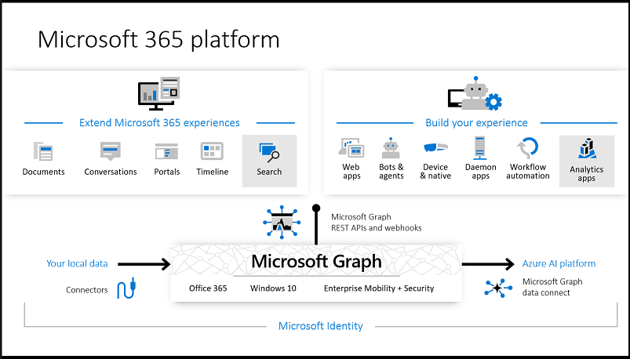
Overview

Slide 3
Gateway to your data in the Microsoft cloud
your app
Web
Apps
Device & Native
Apps
Bots
Background
processes
gateway
Microsoft Graph
Office 365
Windows 10
Enterprise Mobility + Security
Your or your customer’s data
Microsoft identity
Rich content
Deep insights
Real-time updates

Slide 4
#
Demo

Slide 5




Emanuele Bartolesi
//dev.to/kasuken
emanueleb@outlook.com
//dev.to/kasuken
emanueleb@outlook.com
@kasuken
//github.com/kasuken
@kasuken
//twitch.tv/kasuken
@kasuken
//twitch.tv/kasuken

